Slide 1
Notes:
SAS and all other SAS Institute Inc. product or service names are registered trademarks or trademarks of SAS Institute Inc. in the USA and other countries. ® indicates USA registration. Other brand and product names are trademarks of their respective companies.

Slide 2
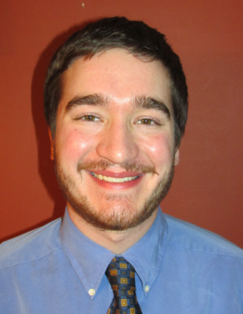
Code Like it Matters: Writing Code That's Readable and Shareable
Presenter
Paul Kaefer, Data Scientist II, UnitedHealthcare
Paul is a data scientist at UnitedHealthcare in Minnesota. He has a B.S. in computer engineering & an M.S. in computational sciences (applied math/data science), both from Marquette University.
While pursuing master’s, Paul worked for Marquette University GasDay, a business housed in a research lab that develops software for natural gas forecasting
After earning his M.S., he spent five months volunteering at the Ifakara Health Institute in Tanzania, leading statistics/R and technical English communication workshops
You are welcome to Tweet @paulkaefer

Slide 3
Code Like It Matters: Writing Code That's Readable and Shareable
Paul Kaefer
Data Scientist II UnitedHealthcare

Slide 4

Today’s Agenda
(this is an update from my MWSUG paper)
Introduction
Why write readable and shareable code?
Best practices for writing
Code standards
Best practices for sharing
Conclusion
Discussion
You are encouraged to interrupt with questions.
Notes:
I do want to stress the updated PAPER. More tips, more details, and LOADS OF REFERENCES!

Slide 5
Why can I be trusted?
Degrees in computer science, experience leading team of developers
Maintained large research codebase; transitioned to version control; documentation in company wiki
Experience with MATLAB, Java, C, python, R, SAS®, etc.
Great feedback from Art, others, at MWSUG, MinnSUG
Everything I will present I use [daily]

Slide 6
Coding Like It Matters
Coming from a background in software engineering, I see gaps in the SAS field
SAS programmers across the board who may work as sole developer or silo on larger team. Either way – not necessarily computer science backgrounds.
SAS contractors might work alone or deliver code they developed alone
Let’s bridge the gap: software engineering + SAS devs

Slide 7
Disclaimers
Only 20 minutes today (MWSUG gave me an hour)
My aim is to begin a discussion and/or share tips
Your organization may already be doing some, or these concepts may be new
I’m sharing what I see as best practices. I appreciate if you have feedback or other ideas.
Notes:
Please feel free to ask questions!

Slide 8
Readability and Shareability
readable – clarity in the structure and content of the code
shareable – how quickly and easily someone new can understand and modify your code
Notes:
Similar meanings
How “pretty” is your code? And is its function self-explanatory?

Slide 9
Why write readable + shareable code?
Software developers often share code with others
Sometimes, that other is your future self
Things change
Database URLs/schemas
Rules and regulations
Column/variable format
Structure of input/config file
Notes:
Have you revisited code you wrote months or years ago? Yeah, it seems like someone else wrote it!

Slide 10
Best practices (WRITING code)
Set of coding standards
Main points: be consistent (across files, coders, and teams)
Examples from the field; any relevant standards
Be consistent! Your coding style is a brand.
Modularity
Comments, comments, comments!
Version control
Don’t keep many lines of commented-out code

Slide 11
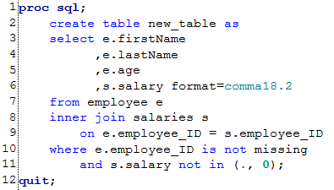
Some coding standards
Format your code nicely
DON’T USE ALL CAPS BECAUSE IT LOOKS ANGRY
Use whitespace wisely
Put commas before variable names?
More in the paper…

Slide 12
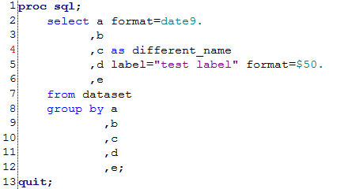

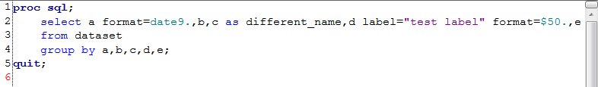

Which is better?

Slide 13


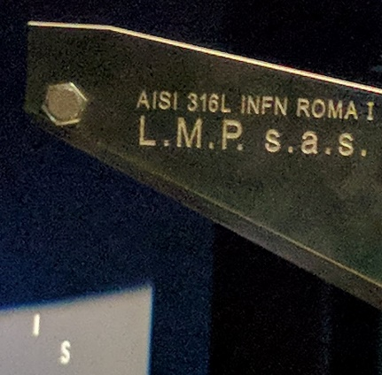
A brief respite…

Slide 14
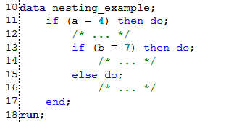
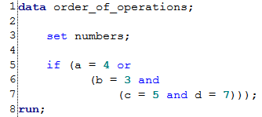
What else?
Standard order-of-operations applies, but you can use parentheses liberally so it’s clearer
Nesting logical statements helps visualize precedence
Note descriptive names, even for work datasets!
Notes:
I might say especially for work dataset names!
Like I said earlier – many more in the full paper, and the MWSUG presentation

Slide 15
Best practices (SHARING code)
VERSION CONTROL!
Notes:
Who uses version control?

Slide 16
Best practices (SHARING code)
VERSION CONTROL!
i.e., outsourcing your memory (computers remember better)
Saves you over and over… (literally)
Documentation
Version control can really help (reference commits; descriptive commit messages)
Code review
Formal, all sitting around a conference table
Software options, including version control tool
Notes:
Brief anecdote, time allowing

Slide 17

Thank you!
Paul Kaefer
UnitedHealthcare
Minnetonka, MN
(952) 979-7347
paul_kaefer@uhc.com
Find me on LinkedIn and Twitter

Slide 18
Your Feedback Counts!
Don't forget to complete the session survey in your conference mobile app.
Go to the Agenda icon in the conference app.
Find this session title and select it.
On the Sessions page, scroll down to Surveys and select the name of the survey.
Complete the survey and click Finish.

